Slide 1
Attach Percentage Analysis – Jumbo & Company
Data Science Internship Assignment
By: Ketan Chauhan

Slide 2
What is this task?
Analyzed device insurance attach % across Jumbo & Company stores
Data covers Aug–Dec
Attach % shows insurance adoption rate
Objective: derive insights & predict January attach %

Slide 3
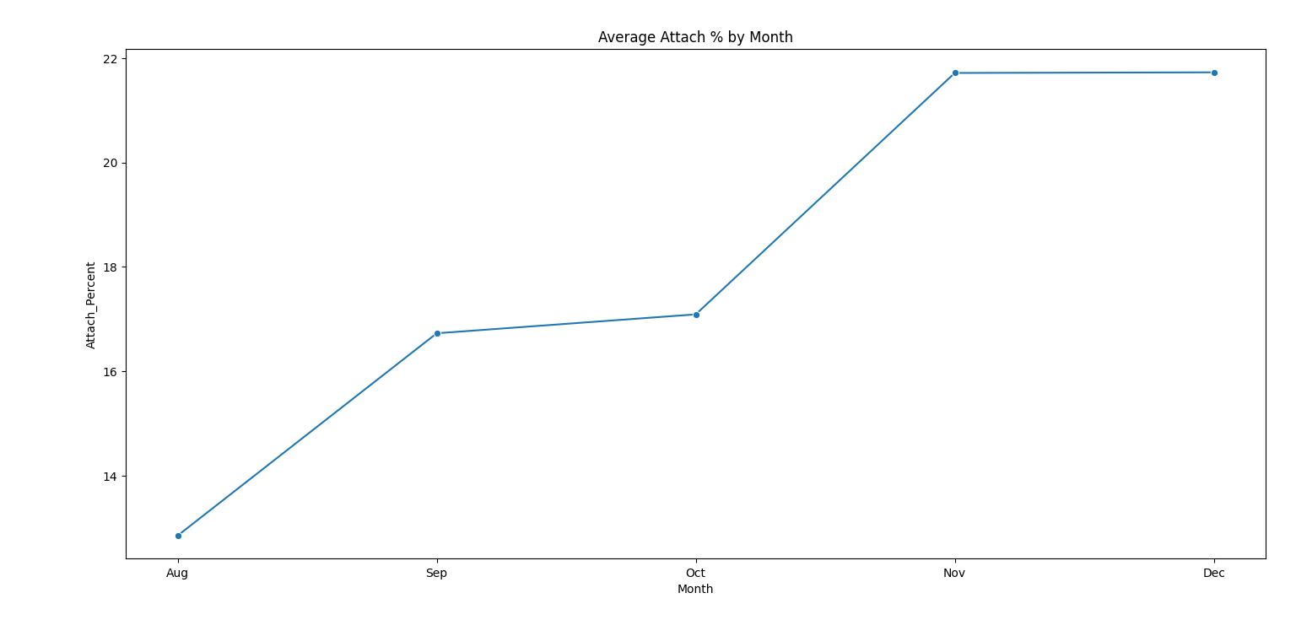
Month-wise Analysis
Attach % shows variation across months
Trend indicates performance change over time
Helps identify seasonality

Slide 4
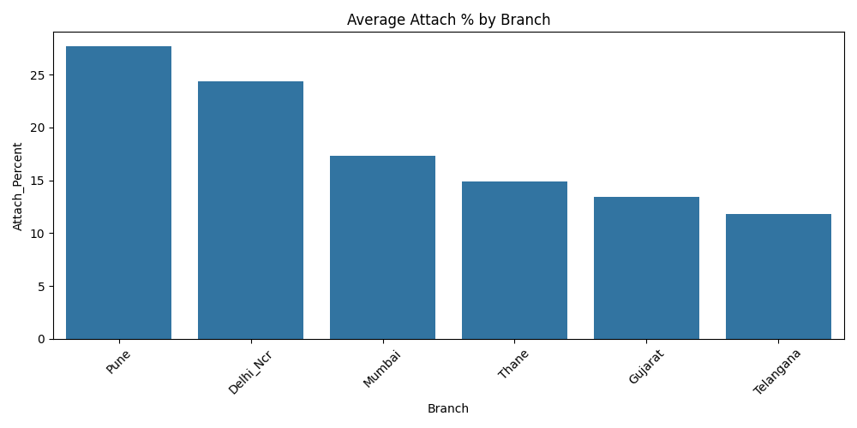
Branch-wise Analysis
Some branches consistently outperform others
Branch-level practices impact attach %
Opportunity to replicate best practices

Slide 5
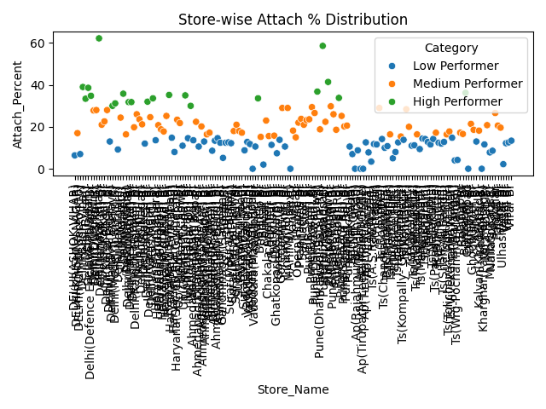
Store Performance
Stores categorized as High / Medium / Low performers
Significant improvement opportunity in low performers
High sales does not always mean high attach %

Slide 6
January Prediction
January attach % predicted at store level
Method used: last 3-month moving average
Suitable due to limited historical data

Slide 7
Recommendations
Focus on high-volume, low-attach stores
Replicate best practices from top stores
Introduce attach-based incentives
Conduct targeted sales training

